Slide 1
Methods of handling missing data.
Presented by: Shreya P Jain
Roll No.: 20-PBD-003
Date presented: 29 Jan 2021
Subject: 1801-Basic Statistical Methods
Presented for: CIA-II

Slide 2

Overview
Introduction
Nature of missing values
Approach to Missing value
Eliminate data objects
Estimate data objects
Single imputation
Multiple imputation methods

Slide 3
MCAR:
missing completely at random:
means that the missing data is unrelated to the values of any variables, in the dataset.
One value is just as likely to be missing as another
Probability for missing data is the same across units .
MAR-missing at random-
Missingness is statistically unrelated to the variable itself, but it is related to some other variables in the data set.
MNAR :missing not at random
when the probability of missing data on a variable Y is related to the values of Y itself

Slide 4
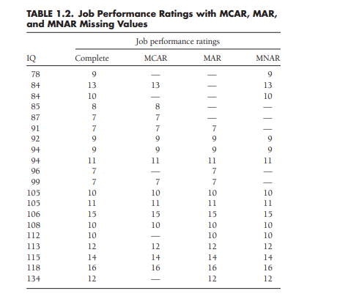
Example:

Slide 5
Note:
We can only check for MCAR using some available tests. eg: Little’s MCAR chi square test,
For other two types, we can never know, or prove statistically what nature the missing values have, we have to look at it intuitively.
They are only literature and not really applied to real life data, because we are always unaware of what missing values
are.

Slide 6
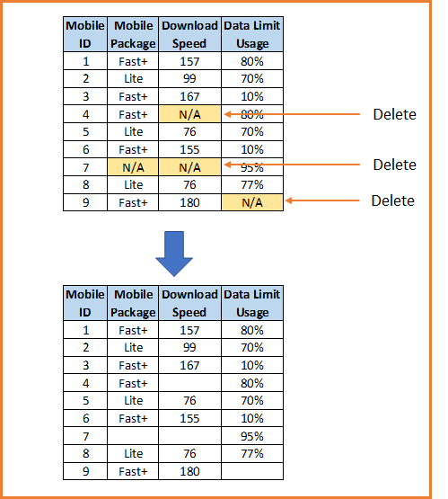
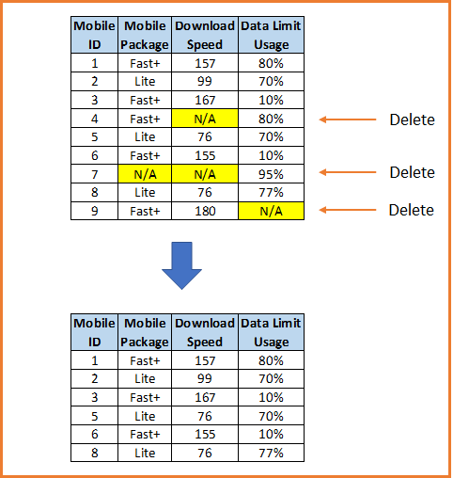
Elimination Techniques
Listwise Deletion Pairwise Deletion
Deletes entire cases/rows of data Requires large sample or important information is lost | Deletes only the missing values. This leads to different sizes of different attributes. The procedure cannot include a particular variable when it has a missing value, but it can still use the case when analyzing other variables with non-missing values. keeps as many cases as possible for each analysis, uses all information possible with each analysis
Notes:
Both require mcar to be satisfied

Slide 7
Single Imputation techniques:

Slide 8
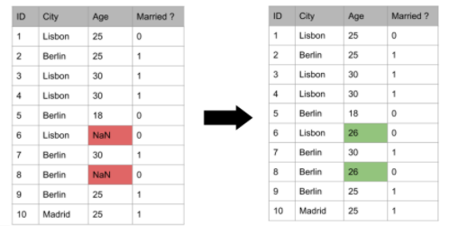
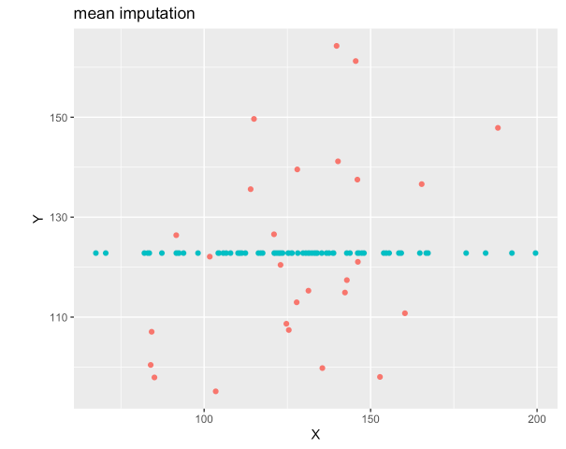
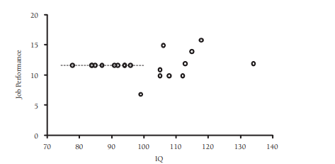
Mean, Median, Mode imputation
Various ways have already discussed in class
Worst possible method

Slide 9
2. AVERAGING THE AVAILABLE ITEMS
Averages the available items across the rows.
Not much research done about this method, so we do not have much details on how accurate this method is.
It is mostly used in clinical questionnaires and company surveys
Disadvantage: this method can create heavy biases.
Also, meaning of scale is different for different participants
 | q1 | q2 | q3 | q4 | q5
participant 1 | 5 | 4 | 9 | 3 | 3
participant 2 | 8 |  | 6 | 5 | 8
participant 3 | 9 | 7 | 5 |  | 6
participant | q1 | q2 | q3 | q4 | q5
participant 1 | 5 | 4 | 9 | 3 | 3
participant 2 | 8 | 6.75 | 6 | 5 | 8 | <-averaging across row
participant 3 | 9 | 7 | 6 | 7 | 6

Slide 10
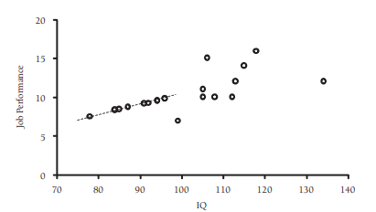
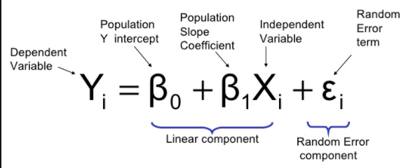
Regression
Advantage: Uses information from the observed data, gives better results than previous ones
Disadvantage: over-estimates model fit and correlation estimates, weakens variance.
Has predictable bias

Slide 11
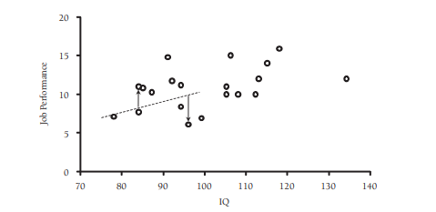
Stochastic regression
uses regression equations to predict the incomplete variables from the complete variables,
Then augmenting each predicted score with a normally distributed residual term.
Adding residuals to the imputed values restores lost variability to the data and effectively eliminates the biases associated with standard regression imputation schemes.
Advantage: it is the only traditional method that gives unbiased parameter estimates under an MAR missing data mechanism.
Disadvantage: standard errors from a singly imputed data set will be inappropriately small which increases chances of type I error

Slide 12
Some other SI methods
(not really good, but often used methods)
Hot deck imputation: collection of techniques that impute the missing data point with a value from a similar observation in the current data set – also known as “matching.
Cold deck imputation: similar to hot deck imputation, only the data is taken from another existing data source
Last observation carried forward
K- nearest neighbors

Slide 13
Maximum likelihood estimatior
Maximum likelihood estimation (MLE) is a statistical technique used for estimating the parameters of a given distribution, using some observed data.
The parameter values are found such that they maximise the likelihood that the process described by the model produced the data that were actually observed.
ML estimate: parameter value that is most likely to have resulted in the observed data.
Using the parameters, and the underlying distribution, we estimate the missing values.
Advantage: uses full information (both complete and incomplete) to calculate the log-likelihood, unbiased parameter estimates with MCAR/MAR data
Disadvantage: Standard errors biased downward but this can be adjusted by using observed information matrix. We have to guess the underlying distribution the variable follows.

Slide 14
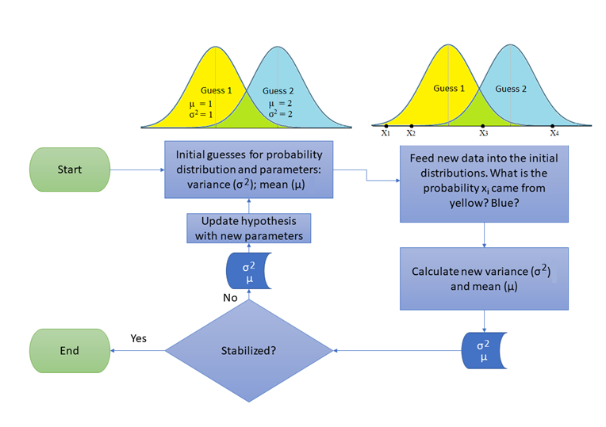
Expectation maximization(EM) Algorithm
Uses Maximum likelihood as underlying method.
EM algorithm utilizes relationships of missing observations, with the unknown
parameters (θ)of the distribution. The missing observation has information about
θ and θ has information about the missing values
Thus, algorithm implements iteratively, till the solution converges.

Slide 15
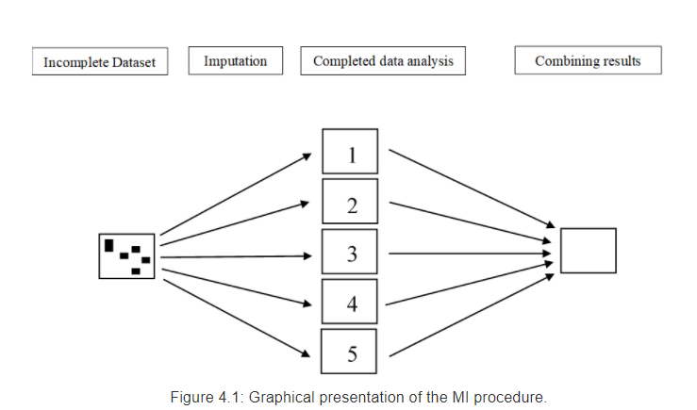
Multiple Imputations
Multiple imputation (MI) appears to be one of the most attractive methods for general- purpose handling of missing data in multivariate analysis. The baisc idea:
Imputation – Similar to single imputation, missing values are imputed. However, the imputed values are drawn m times from a distribution rather than just once. At the end of this step, there should be m completed datasets.
Analysis – Each of the m datasets is analyzed. At the end of this step there should be m analyses.
Pooling – The m results are consolidated into one result by calculating the mean, variance, and confidence interval of the variable of concern^{[10][11]} or by combining simulations from each separate model.^{[12]}

Slide 16
Some methods using MI
MICE procedure:- works very well with MAR data
EM-MCMC algorithm: Expectation Maximization Markov Chain Monte-Carlo algorithm.
Random sample
Some packages in R
MICE (Multivariate Imputation via Chained Equations): Creating multiple imputations as compared to a single imputation (such as mean) takes care of uncertainty in missing values. It assumes MAR
Amelia:This package also performs multiple imputation to deal with missing values. It is enabled with bootstrap based EMB algorithm which makes it faster and robust to impute many variables including cross sectional, time series data etc. All variables in a data set have Multivariate Normal Distribution (MVN) and MAR
missForest: an implementation of random forest algorithm. It’s a non parametric imputation method applicable to various variable types. It builds a random forest model for each variable. Then it uses the model to predict missing values in the variable with the help of observed values. It yield OOB (out of bag) imputation error estimate. Moreover, it provides high level of control on imputation process.

Slide 17
What if there are too many missing values in a variable?
If there are too many missing values for a variable, i.e, only very less data for the variable is available, we can take to dropping the variable, with some information loss. But this should be done, only after detailed analysis of the variable, and it must be made sure, no important information is lost.

Slide 18
Thank you!

